Slide 1
iTSikhwal
Cricket Scoreboard Management System
Date : 18-05-22

Slide 2
Why?
Cricket is a very popular sport in India as well as in other cricket playing countries. Information about a cricket match is provided using a scorecard. The analysis of such scorecards generate information important for players, team management, selection boards and other interested parties since they will lead to better judgement about players, their strengths and weaknesses, and performance as a team. This information is in the form of statistical data that changes with every cricket match. The design and development of such an information system for Limited over cricket is described in this paper. Input of the system is mainly in the form of cricket live video or normal (mp4) file. Presentation of statistical information for series, country, match, team statistics, batting records, bowling records, fielding, wicket keeping, player profile and all round performance to the users, and the capability to stream live video to YouTube or other online platforms that will be the output of the system.

Slide 3
User Segment & Pain Points
Cricket score display is a simple project built using the vb.net programming language. It uses file handling to store various information regarding runs, wickets, overs, extras and many more. This program can display runs, wickets, names of batsmen, bowlers, overs, economy of bowler, strike rate of batsmen, etc. It also includes the feature of calculating the total balls played and total score hit by the batting team as well as total overs bowled by the bowling team. It displays the final score sheet in the end with all the necessary details of each individual player and shows the status of the game. This project aims at reducing the time travel involved in entering the scores manually in paper and helps in minimizing human errors while entering the scores

Slide 4
Current Landscape
The existing Cricket Score Board system of watching cricket is generally on the television. Most matches are not scheduled on holidays and this will allow people access to the match regardless of their location. The existing system is used software saves all the team and team members games format system manually. Manage the activities like manual decision making, processing, announcement, scoring data and handling players & team information are very tough process. Moreover which will make lot of confusions and risks to make further process. This leads to wrong decision making in the event. The existing system is to manually alerts the system to customer and maintains the player details, and status are in records. It will be more difficult to maintain and gathering information about specific records. It will take more time. As there is lot of data work involved, skilled staffs are used. So it becomes dependable for the management on these people. The reports are not verified to the highest extend to avoid any miscommunication and misfortune of the center. The existing system of watching cricket is generally on the television. Most matches are not scheduled on holidays and this will allow people access to the match regardless of their location. Some sites do exist that display text commentary but they are very impersonal.

Slide 5
DEMO
The proposed Cricket Scoreboard Management System will allow people to stream the video of the match anywhere and read text and voice based commentary as well, while making cricket viewing a social experience by allowing friends to share text and audio commentary. The commentary will be available post the match as well for review. Main objective of the project is to develop the software for the event requirement. In this project used to maintain the details in database so easily retrieve the details from the database. This system also having the details of player and match are maintained in the repository management system. The reports are useful to maintain the match and run rate system and complete the work as simple and as quick. Report is generated and saved in non-editable format. The proposed system commentary will be available post the match as well for review.The various software components in administrator module updates the information about match details, player details. Censoring of comments can be done during or after the match by the admin. Cricket Scoreboard Management System The registration process includes username, password, address, phone etc. Once the registration process is completed successfully, then the user can login with the username and password and then search can be easily performed. This module will allow access to all the consumption features of the system, such as listening to official or unofficial commentary, posting comments, viewing scores and cricket statistics and video live streaming . Commentary This module can be used by any user, admin update commentary to particular match for public use. The module will adjust a time itself accurately depending on the score commentary. Viewers of the commentary and and video live streaming may experience a lag which will depend on internet speed for the user and for the commentator. The report can be generated for user details, score details and live videos on YouTube. The admin can view the report accordingly.

Slide 6
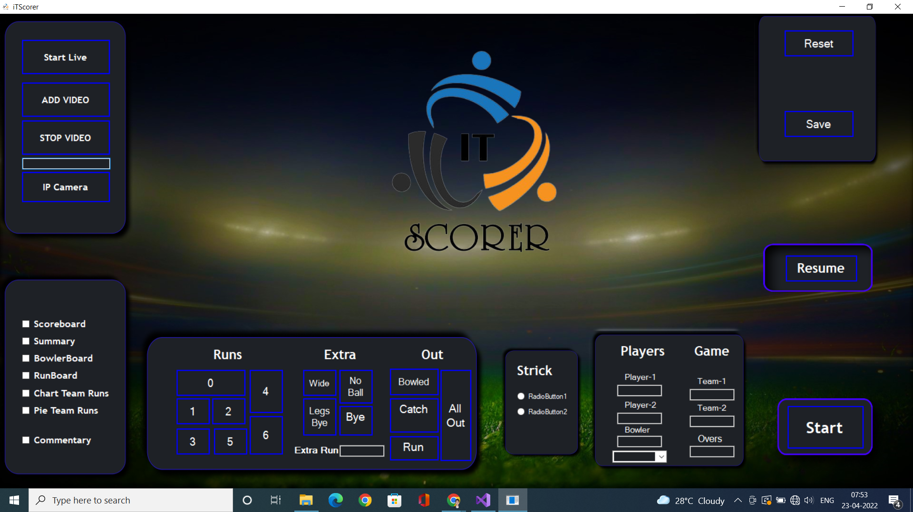

Slide 7
Key Differentiators & Adoption Plan
Advantages of the Proposed System
1. Easily maintain all the player details.
2. Report generation is easier.
3. Easy to maintain score details.
4. Ensure user security.

Slide 8
Future Vision
There is scope for future development of this project. The world of computer fields is not static; it is always subject to be dynamic. The technology which is famous today becomes outdated the very next day. To keep abstract of technical improvements, the system may be further refined. So, it is not concluded. Yet it will improve with further enhancements. Enhancements can be done in an efficient manner. We can even update the same with further modification establishment and can be integrated with minimal modification. Thus the project is flexible and can be enhanced at anytime with more advanced features.
Some Advanced Features :
1. 360 video in System
2. 360 live video streaming

Slide 9
Your Aha Moment!
It is concluded that the application works well and satisfy the end users. The application is tested very well and errors are properly debugged. The application is simultaneously accessed from more than one system. Simultaneous login from more than one place is tested. This system is user friendly so everyone can use easily. Proper documentation is provided. The end user can easily understand how the whole system is implemented by going through the documentation. The system is tested, implemented and the performance is found to be satisfactory. All necessary output is generated. Thus, the project is completed successfully. Further enhancements can be made to the application, so that the application functions very attractive and useful manner than the present one. The speed of the transactions become more enough now.

Slide 10
Thank You
Team member names

